Slide 1
MySql Training
Umadevi Balakrishnan

Slide 2
Agenda
Database
SQL
DDL
DML

Slide 3

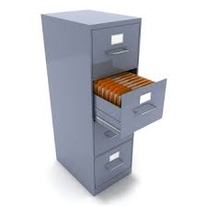

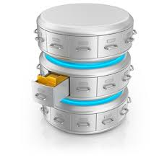

What is Database???

Slide 4
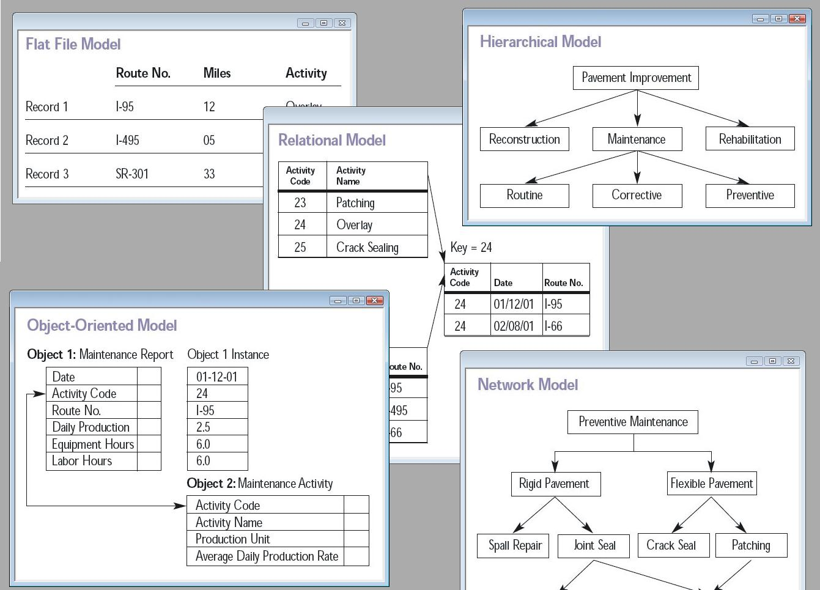
Modes of storing data

Slide 5
Modes of storing data
Hierarchical Data model
Tree Structure
IBM’s Information management system, IMS
Network Data Model
Pointers
Honeywell's Integrated Data Store, IDS
Relational Data Model
Tables
MSSQL , Oracle , Sybase,MySql

Slide 6



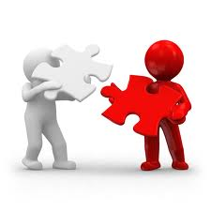
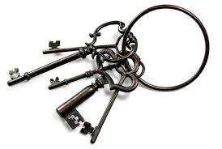
RDBMS
Relational
DBMS
Database

Slide 7

SQL ???
Structured Query Language
Special purpose programming language for managing RDBMS
Developed by IBM

Slide 8


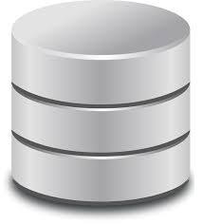
Why SQL ???

Slide 9
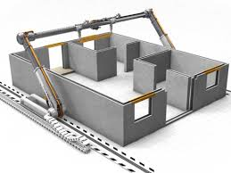


Data Definition Language

Slide 10



Data Manipulation Language

Slide 11


Data Control Language

Slide 12

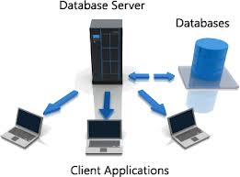
Power of SQL ???

